Slide 1
Gene Co-expression Visualization
02-601 Project
Zhiyun Gong

Slide 2
Why Co-expression?
Gene Expression Profile
Co-expressed gene groups
Functional Enrichment Analysis
Gene Co-expression Network
A gene co-expression network (GCN) is an undirected graph, where each node corresponds to a gene, and a pair of nodes is connected with an edge if there is a significant co-expression relationship between them.
(https://en.wikipedia.org/wiki/Gene_co-expression_network)

Slide 3
Methods
Visualization
Pairwise Pearson correlation
Co-expression relationship graph
HTML+D3.js
Depth-first
Search
Co-expressed gene groups
Co-expressed gene pairs
corr > 0.8
Undirected graph
Connected components
Functional enrichment
analyisis
ShinyGO
(external)

Slide 4
Results
Text-based results written in flat files
Web-based results containing tables and interactive graphs

Slide 5
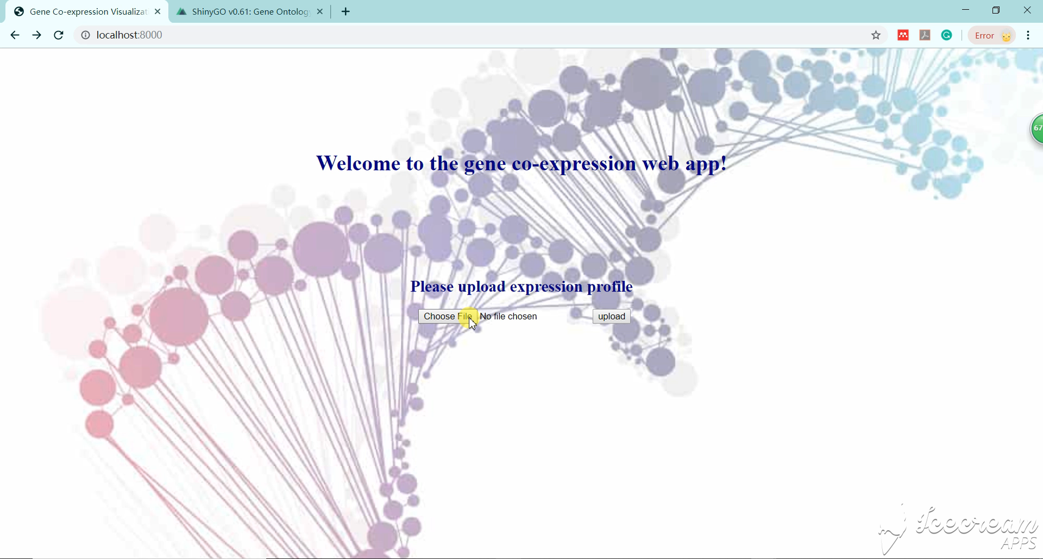
Web App

Slide 6
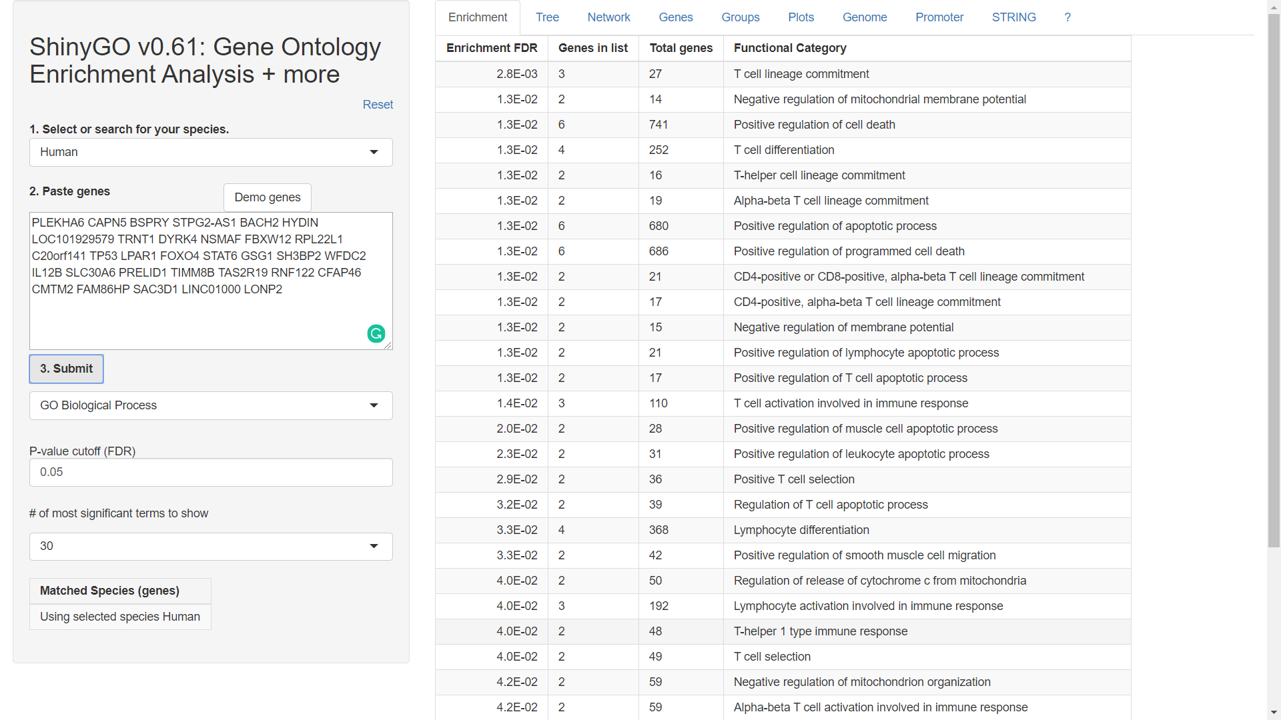
Gene Ontology (GO) enrichment
ShinyGO v0.61(http://bioinformatics.sdstate.edu/go/)

Slide 7
Future directions
Add an ID conversion function
Add a built-in GO enrichment function and write the results to text files
Add a new feature to the web app that copies and pastes a group of gene names to the shinyGO web app automatically
Parallelize the graph traverse step when larger datasets are given

Slide 8
Thank you! 2019.12.5

